Slide 1
Employee Data Analysis using Excel
STUDENT NAME: S.Sreeja
REGISTER NO: 312214914
DEPARTMENT: Bcom(CA)
COLLEGE: Annai veilankannai’s college for women

Slide 2
PROJECT TITLE
Employee Performance Analysis using Excel

Slide 3


AGENDA
Problem Statement
Project Overview
End Users
Our Solution and Proposition
Dataset Description
Modelling Approach
Results and Discussion
Conclusion
3/21/2024 Annual Review

Slide 4

PROBLEM STATEMENT
Identify the problem.Put the problem into context.Find the root cause.Describe your ideal outcome.Propose a solution and outline its benefits.
The problem statement aims to highlight the pressing issue the research intends to address. It should be concise and to the point.
The problem statement aims to highlight the pressing issue the research intends to address. It should be concise and to the point.
Data analysis is a process of finding answers to questions or solving problems using data. But before you can dive into the data, you need to have a clear problem statement that defines what you are trying to achieve, why it matters, and how you will measure success.

Slide 5

PROJECT OVERVIEW
.
At their most basic level, data analytics projects involve using historical and present project data to enable efficient project delivery decisions. This includes the following: Descriptive analysis offers information in the most efficient way possible
Data analysis is a process for obtaining raw data, and subsequently converting it into information useful for decision-making by users. Data is collected and analyzed to answer questions, test hypotheses, or disprove theories.
Data summaries use descriptive (summary) statistics to present collected research data in a logical, meaningful, and efficient way. In most cases, data summaries do not make inferences about the data and its ability to prove .

Slide 6

WHO ARE THE END USERS?
End users are the people who use a product or service, and they can be the target of data analysis: DefinitionAn end user is a person or entity that uses a product or service, and they are different from the customer who buys it. RoleEnd users are often at the operational level of an organization, and they may be the ones who make the final decision to adopt a product or service. NeedsEnd users can have different levels of technical expertise, so it's important to consider their needs and preferences when designing a product or service. Data analysisEnd users can be empowered to participate in data analysis, which can help companies make data-driven decisions. Data analyticsData analytics is the process of examining data to find trends and draw conclusions. It's used by many businesses, including those in retail, agriculture, banking, and government.

Slide 7

OUR SOLUTION AND ITS VALUE PROPOSITION
Here are some ways that data analytics can strengthen a value proposition:Identify customer needs: Data analytics can help identify customer needs and pain points.Validate assumptions: Data analytics can help validate assumptions and hypotheses.Demonstrate value: Data analytics can help demonstrate a company's value and impact.Optimize messaging: Data analytics can help optimize a company's messaging and delivery.

Slide 8
Dataset Description
Dataset MeaningA data set is an ordered collection of data. As we know, a collection of information obtained through observations, measurements, study, or analysis is referred to as data. It could include information such as facts, numbers, figures, names, or even basic descriptions of objects.
At a minimum, it should contain a list of every file in the data set and a brief description of the data included in each file. Ideally, there should be a detailed description of the data in each file including software used, data units (i.e. tabular columns, data records, etc.)

Slide 9

THE "WOW" IN OUR SOLUTION
Data analytics can also help companies track which products and services are performing well and predict sales trends—and leverage this qualitative
Data analytics helps you make better decisionsWith a data skill set, you'll be able to analyze social media engagement trends, customer buying behaviour, and demographic info to help reach your sales goals and better connect with your audience.
3/21/2024 Annual Review
9

Slide 10
MODELLING
Data Modeling ExamplesER (Entity-Relationship) Model. This model is based on the notion of real-world entities and relationships among them. ...Hierarchical Model. ...Network Model. ...Relational Model. ...Object-Oriented Database Model. ...Object-Relational Model.
An analytical data model represents a set of rules, that once applied to one or more tables in a database, creates a modified view of an existing table or a new table altogether. In other words, an analytical data model can be used repeatedly to transform raw data
10

Slide 11
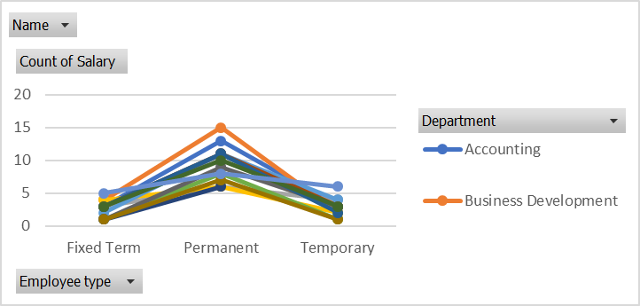
RESULTS
11

Slide 12
conclusion
1. Here are some tips for drawing conclusions from data: Know your data source, Define your question and hypothesis, Choose the right method and tool, Interpret the results and check for errors, and Communicate your findings and insights. Data analysis can help you: make informed decisions, identify opportunities for improvement, drive innovation, and support or debunk previous studies.
2. Making Informed Conclusions: Data analysis helps researchers draw meaningful and evidence-based conclusions from their research findings. It provides a quantitative basis for making claims and recommendations.

